Slide 1
Modeling Electronic Arts’ Market Success From Game Data
Peter Gottleib Malik Jackson Patrick Jenkins

Slide 2
Introduction
Motivation
Video game industry is growing rapidly
People are interested in money
Limited research done in this specific area
Scope
Electronic Arts (mostly games, consistent releases, AAA)
2004-2016
Annual analysis
Goal
Attempt to predict trends in earnings from video game data
Produce a general method that can be applied to other related topics
Notes:
EA was picked since it is a large publisher who’s primary business is video game development
Kaggle is a website with published datasets for running ML and stats “competitions”
Stock changes were obtained by taking difference from the first of the month with the last of the month and summing for the year

Slide 3
Compiling the Dataset
Kaggle
Filtered for EA
Removed incomplete records
EA Quarterly Earnings reports
Combined into yearly results
Filtered Kaggle data set to match years
Yahoo! Finance
Stock changes
Notes:
EA was picked since it is a large publisher who’s primary business is video game development
Kaggle is a website with published datasets for running ML and stats “competitions”
Stock changes were obtained by taking difference from the first of the month with the last of the month and summing for the year

Slide 4
Data Example
Release Year | Global Sales | Avg. Critic Score | … | Net Income | Stock Change
2004 | $62.3M | 77.11 | … | $577M | 12.86
2011 | $54.15M | 75.67 | … | -$331M | -2.5
Notes:
Many more features including number of games in a genre, other sales figures, game rating, total games.
Net Income and Stock Change were used as response variable

Slide 5
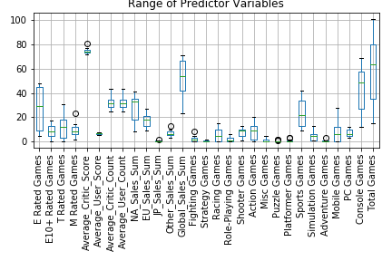

Slide 6
Models
Sklearn Regression Models
Linear Regression
Polynomial Regression (SVR) (Deg.2-5)
Multiple independent predictors may cause multicollinearity
Lasso Regression (L1 Regularization)
Ridge Regression (L2 Regularization)

Slide 7
Computation Methodology
Problem : Small Dataset ->
Few Training and Testing Examples ->
Potentially Non-Generalizable Model
Solution : Generate many (1000) Models
Train and Test each model on a random selection of data (75/25 Split)
Average all metrics (Coefficient of Determination), (Mean Squared Error)

Slide 8
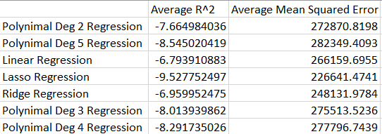
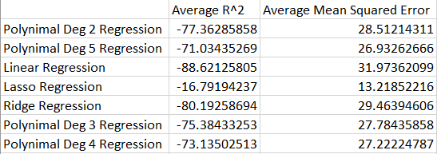
Results - Metrics Table
Net Income Results
Stock Change Results

Slide 9
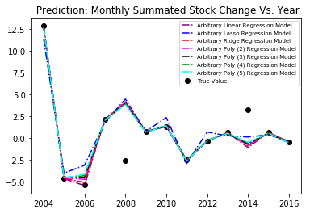
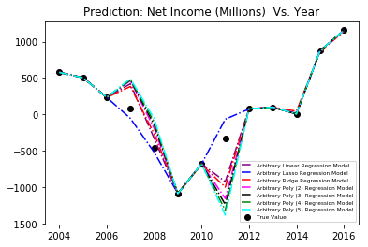
Results - Financial Predictions

Slide 10
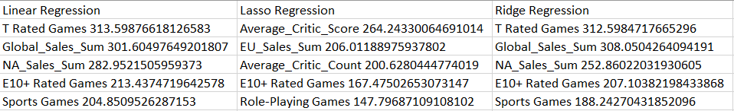
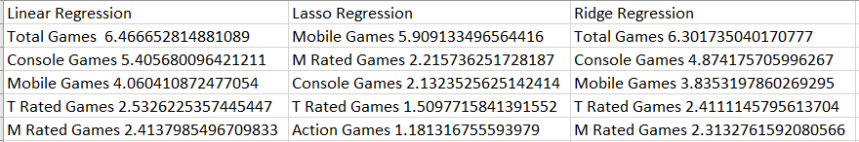
Results - Most Important Predictor Variables
Net Income Results
Stock Change Results

Slide 11
Conclusions and Future Work
Attempts at predicting were poor
After 1000 simulations of producing each model, each results was very different
Coefficient of determination was negative, indicating just guessing the average is better than prediction
Likely due to lack of data in addition to dynamic nature of financial data
Remedies
We’d like to get more specific data, break it down into quarters (potentially months)
Requires finding specifically when every game of publisher was released in the year
Use several companies to avoid potential biases in a specific company
Combination of features/feature selection
Use other financial metrics than yearly net income and stock change
Would be interested in incorporating word of mouth data
Performing analysis as we get data

